Slide 1
Trans & Nonbinary Sex Ed
Buster Buchanan | He/Him
Health Equity Advocate
buchanan856@ucsb.edu
Updated Spring 2023

Slide 2
The Plan
Bodies and Hormones *Genitals discussed*
Care and Upkeep: Who needs what?
Sex and Relationships
Optional: Special Topics
Q&A
Notes:
The information in the presentation can be interpreted with or without the presence of a partner or partners and may be relevant and useful whether or not you are partnered or ever plan to have sex. In this workshop I will be using the terms Penis and Vagina/Vulva to refer to genitals.

Slide 3
Starting Assumptions
Everyone has a body, and all bodies are subject to health/illness regardless of our choices
Not everyone is or wants to be sexually active
The quality, content, and availability of sex ed in the US varies widely
Every person deserves accurate, accessible information about their bodies, health, and sexuality
Some trans people transition using hormones and/or surgery, and some don’t
Some of the topics discussed in this space may feel uncomfortable, private, or dysphoric. You are welcome to leave or mute me at any time.
Nobody (including me) knows everything about this topic
Every person is the expert on their own experience and identity
Notes:
Afterwards, I will send out the slides to anyone registered in case you want to explore on your own.

Slide 4
What kind of bodies do trans people have?
two large surveys* of trans people in the US found that the majority of trans people have not had any gender-related surgeries, and a little less than half have ever used hormones as part of their transition
12-23% of trans women have had vaginoplasty
11-21% trans women have had breast augmentation
36-43% of trans men have had chest surgery
only 2-3% of trans men have had phalloplasty
nonbinary people were less likely to have had gender-affirming surgeries and hormone therapy
many trans people do not have any interest in genital or chest surgery
*The 2015 U.S. Transgender Survey and the 2011 National Transgender Discrimination Survey

Slide 5
*Medical diagrams of genitals next two slides*

Slide 6
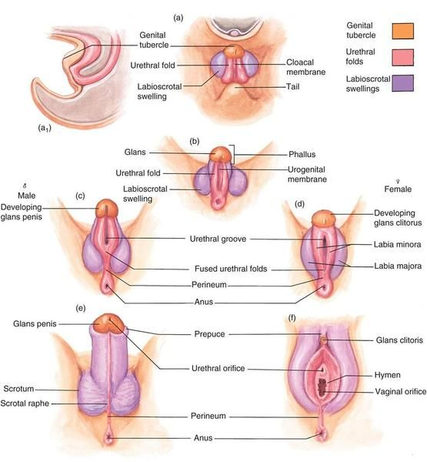
Notes:
These diagrams show how all genitals form from the same key tissues. On the left is the development of a penis and the right, a vagina. This diagram may also help you picture which parts of one’s genitals would be used if they were to undergo gender-affirming bottom surgery. For example, the clitorus would become the tip of the penis for someone on testosterone HRT.

Slide 7
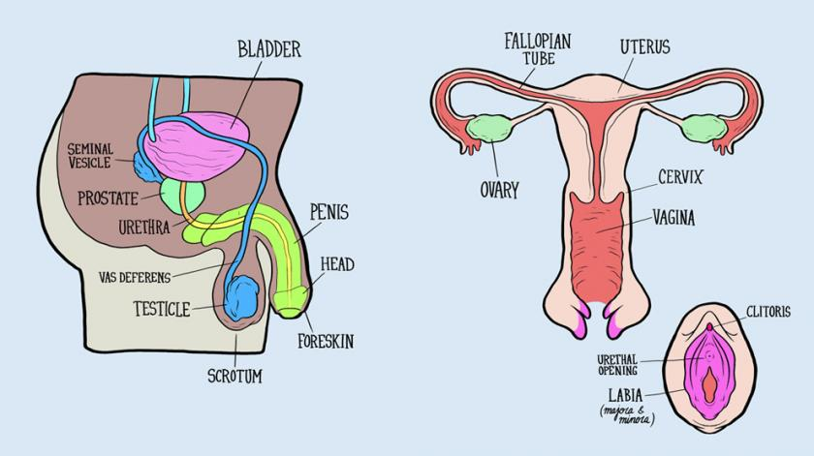
Notes:
General overview of genitals and reproductive systems.
Talk about Pelvic floor muscles.
Left: inguinal canals, prostate
Right: cervix, vagina, clitoris

Slide 8
Penis Owner’s Manual
Penises should be cleaned regularly with warm water and mild soap. Make sure to clean under the foreskin if applicable. Do not scrub.
Anything that comes into contact with the urethral opening should be clean.
Penis-owners can get Urinary Tract Infections too. Make sure to pee after sex involving your penis, especially anal sex without a condom.
The prostate, a gland that produces seminal fluid, is at high risk for cancer. If you notice any irregularities, check with your doctor for a prostate exam.
Inguinal canals, where the testicles drop from during puberty, are commonly used in tucking but may also be a potential source of pleasure in sex and masturbation.
To add moisture when externally masturbating, consider lube or a fragrance-free lotion. Never use lotion internally or for penetration.
Notes:
Irregularities that may be signs of prostate cancer - change in frequency of urination or ability to urinate, blood in urine or semen, pain while peeing, sudden onset of erectile dysfunction, pain in surrounding areas

Slide 9
Vulva Owner’s Manual
Most vaginas are self-cleaning and should NEVER be cleaned using any kind of soap, detergent, douche, etc, especially anything with dyes or fragrances
Anything that comes into contact with the urethral opening or vagina should be clean (including packers/STPs, toys, dilators, hands or other body parts)
Always wipe front to back after using the toilet
Pee before and after sex that involves penetration OR touching your genitals
Vaginal discharge is normal BUT if discharge takes on strong colors, smells, or textures or if the vulva or vagina become itchy or painful, talk to a care provider as this may be a sign of infection
It should not hurt or cause bleeding to be penetrated vaginally, even the first time
Use additional lubrication, a condom or glove, slow down, or try longer foreplay
It is normal to sometimes get pimples on the labia (but when in doubt, have bumps checked out by a medical professional)
Clitoris placement varies by individual and may affect what activities you find pleasurable
Notes:
If bleeding persists longer than an hour or is more than just spotting, see a doctor

Slide 10
Bodies and Hormones
If you are on hormone replacement therapy, you may experience…
Fat redistribution (body and face)
Weight gain or loss
Changes in appetite
Changes in skin texture/softness
Changes in hair growth, texture, or color
Changes in smell, acne, sweat, etc.
Growth (breast size, shoe size, height, genitals, etc.)
Changes in who you are attracted to
Changes in libido
Changes in how orgasms feel
Changes in sexual function
Decrease in fertility
Changes vary by person and you will likely only experience some of these

Slide 11
What if I’m on estrogen?
People taking estrogen might experience
fewer spontaneous erections and nocturnal emissions
softer erections
reduced testicular volume
thinner and more liquid seminal fluid
orgasms that feel less intense but more full-body rather than genital-focused
difficulty becoming erect
changes in fertility
Increased nipple sensitivity
Some changes are permanent, but many are reversible
If you want to maintain erectile function, options like Viagra (Sildenafil) and Cialis (Tadalafil) are available and will not compromise transition progress
You may still be able to make someone pregnant. The effects of estrogen on fertility varies greatly by person
Notes:
Permanent: breast growth
Reversible: everything else (skin texture, body fat redistribution, cycles)
Research:: how does viagra affect fertility

Slide 12
What if I’m on testosterone?
People taking testosterone might experience
increased sex drive
pause or stopping of period, symptoms of menopause
growth of clitoris
thicker vaginal discharge, particularly during arousal
dryness and/or fragility of vaginal tissue, possibly vaginal atrophy
changes in fertility
Many changes are permanent, but some are reversible
Vaginal dryness or fragility can be treated with lubricant, vaginal moisturizers, or local/systemic estrogens without compromising transition progress
You may still be able to become pregnant
Bottom growth may have different sensitivity than a pre-T clitoris
Never put testosterone gel or cypionate directly on your genitals, genital safe testosterone cream can be prescribed by your doctor
Notes:
A study published at the end of last year found that trans men undergoing assisted reproduction had outcomes comparable with cisgender women even if they had been on testosterone before trying to become pregnant, but there’s still a lot we don’t know.
You might want to opt for looser underwear during the first few months on testosterone to decrease discomfort from T-growth

Slide 13
tucking
Listen to your body, take breaks: tucking should not be painful or restrict normal movement
Never force or pull hard on any part of your genitals
Use tucking underwear/gaffs or skin-friendly tape if you can, (baby powder for chafing)
Can affect fertility; studies showed a 97% decrease of sperm production after 2 months of daily tucking (can be reversed after not tucking for a few months)*
Tucking Guide
*R Mieusset et al. “The potential of mild testicular heating as a safe, effective and reversible contraceptive method.” International Journal of Andrology, 1994.
Mieusset R, Bujan L, Mansat A, Pontonnier F, Grandjean H. “Hyperthermia and human spermatogenesis: enhancement of the inhibitory effect obtained by 'artificial cryptorchidism'.” Int J Androl. 1987 Aug;10(4):571-80. doi: 10.1111/j.1365-2605.1987.tb00356.x. PMID: 2888735.
Notes:
Temperature is a key factor in scrotal health and sperm production, long-term daily tucking may affect fertility.

Slide 14
binding
ONLY bind with a binder or skin-safe binding tape! Duct tape and bandages can damage your ribcage.
Take regular breaks from binding, don’t bind more than 8-10 hours at a time
Listen to your body: binding should not be painful or restrict normal movement
Some sex involves lots of movement and exercise; if binding during sex it’s best to size up or wear a compression top instead
Binding Guide
Notes:
Never wrap bandages or tape around your ribcage as this can cause permanent rib damage, if your ribcage aches after binding, you need to take a binding break.

Slide 15
How do I care for my body when I don’t even like my body?
People who experience dysphoria sometimes struggle to care for their bodies
If you struggle with medical care
Bring an advocate who is prepared to support you in ways that feel safer
Be prepared to talk clearly with your provider about what you need to feel safe and welcome (make a list and/or send an email before your appointment)
If you struggle with hygiene
Reduce visibility! cover the mirror, turn on only a nightlight, or wear a bathing suit
Cleansing wipes (ReadyBath) and dry shampoo
TransTape and Water-safe prosthetics
Gender affirming hygiene supplies; women’s deodorant, men’s body wash, a shampoo bar?
If you struggle with food restriction or self harm
Look into harm-reduction strategies, prioritize safety
Notes:
Dysphoria can make caring for our bodies really hard. Caring for our bodies is harder when we don’t want to think about, acknowledge, or touch our bodies.
It might help to buy affirming hygiene supplies, women’s deodorant anyone? Other small gender-affirming items
if you struggle with food restriction or self harm
explore harm-reduction options, focus on safety
resources at CAPS and Student Health

Slide 16
who needs…
Who: Anyone who is sexually active
What: HPV, Hepatitis A/B (both are a 3 shot series administered over multiple months)
When: between 11 and 26 years old for HPV, anytime for Hepatitis
STI vaccinations?

Slide 17
who needs…
Who: Only people who have a cervix
What: Test involves a swab of the cervix to test for cancer cells
When: Every 3 years for most adults
HPV test or Pap smear?
Notes:
Pap Smear - This exam looks for precancers – cell changes on the cervix that might become cervical cancer if they are not treated appropriately. Your doctor will likely use a swab to collect cells from the inside of your cervix. The term “Pap smear” is named after Georgios Papanikolaou, the doctor who determined its use in detecting early signs that could lead to cervical cancer.

Slide 18
who needs…
Who: People who have a vagina
What: Involves insertion of fingers and usually a speculum into the vagina
When:
Every 3 years with HPV/Pap test if you have a cervix
Every 3-5 years if you have had your cervix removed
Every 4 years if you have a prostate
a pelvic exam?
Notes:
Speculum - a speculum is a tool primarily used by gynecologists which, when inserted into the vagina, widens your vaginal walls just enough for your provider to see your vaginal canal and your cervix.

Slide 19
who needs…
Who: People who have prostates
What: Test involves insertion of the fingers into the anus or vagina to feel the prostate
When: Every 4 years starting age 40
a prostate exam?

Slide 20
who needs…
Who: People who have breasts*
What: Involves touching the breast tissue and/or a specialized medical imaging device
When:
Every 1-3 years between age 20 and 40
Every year starting age 40
Mammograms after age 45-50
*Everyone has some breast tissue and therefore can get breast cancer, it is important to get an exam if you observe any abnormalities in your chest tissue
a breast exam?
Notes:
Even those who have had a mastectomy may still have some breast tissue and should see a doctor if they observe any abnormalities in their chest tissue.

Slide 21
who needs…
Who: People who can get pregnant
What: Urine and/or blood is collected, home tests available
When:
If there is a chance you may be pregnant
Before engaging in certain procedures that would be contraindicated if pregnant (e.g. most bottom surgeries)
a pregnancy test?

Slide 22
who needs…
Who: Everyone who is sexually active
What:
Tests might involve sampling blood, urine, saliva and/or skin swabs
“Standard” STIs tested for are HIV, chlamydia, gonorrhea, and syphilis but you can ask for others!
When:
If you experience symptoms
If you learn that someone you had sexual contact with has tested positive
If you are planning to have new sexual partners
testing for STIs/HIV?

Slide 23
HIV + AIDS
PrEP(Pre-Exposure Prophylaxis) and PEP (Post-Exposure Prophylaxis) are antiretrovirals taken by people who are HIV negative to reduce the chances of contracting HIV
PrEP might be a good option if you:
have multiple partners
are in a relationship with someone who does not respect your boundaries
engage in sex work
share needles when using hormones or non-prescription drugs
have one or more partners who fit the above, who know that they are HIV+, or who do not know their status
Antiretroviral therapy (ART) is a lifelong combination of drugs taken by HIV positive individuals to reduce the effects of HIV and the likeliness of transmission. There is currently no cure for HIV.

Slide 24
you are allowed to use any part of your body that you want for pleasure.
Notes:
And you are allowed to NOT use any part of your body for any reason.

Slide 25
using particular parts of your body for pleasure does not mean you have a particular gender or sexuality
Notes:
Anyone can have any type of sex, sex is not gendered. You are able to explore sex acts without it having any impact on your gender or sexuality. Using your genitals for pleasure does not invalidate your transness in any way. Trans men can have vaginal sex and trans women can use their penis for sex.

Slide 26
Sex and Sexuality
Gender and sexuality (and sex too) are fluid spectrums
What you think you know about yourself may change over time and that is ok
Labels
Labels and identity terms are tools to help us explore ourselves and find community
You get to decide what language you use to describe yourself
That language may change in different places, with different people, and over time as you explore your gender
Sex is not required for a fulfilling life or a loving relationship
If, when, how often, and with who you have sex is and should only be your decision
Many trans people also fall on the asexuality spectrum
Dysphoria and body dissociation can result in a lack of sexual attraction or sexual interest
Asexuality due to outside factors such as gender dysphoria or trauma is still asexuality
Your experience of sexual attraction may fluctuate along with your healing or gender exploration
Most of the information in this sex ed can be interpreted without the presence of a partner
Notes:
The way you feel not is not the way you will feel forever

Slide 27
Warming-up to Sex
Masturbation, solo-sex, self-pleasure, jerkin it, self-love, etc.
Maturbation is a healthy and normal way to explore your body and learn what brings you pleasure, but don’t feel pressured to engage if it makes you uncomfortable or dysphoric
Only you can decide whether or not you consider masturbation to be sex
Masturbation may be practiced solo or in the presence of your partner(s)
Foreplay
Helps increase arousal and ease you into the mood, let’s your body know what’s going on
Can be fun on its own and may not always lead to sex
Foreplay can be especially important for people with vaginas to facilitate arousal and natural lubrication
Consent
Consent and arousal are not synonymous
Make sure you have enthusiastic consent from you partner(s)
It is ok for you or your partner(s) to say no in the moment, promises and pasts are not consent

Slide 28
Change and Communication
Have you talked about sex with your partner(s)?
It is never too late to introduce or reintroduce a conversation about sex and intimacy.
Bodies, minds, feelings, and desires are constantly changing. It is natural and healthy to occasionally check in with your partner(s) about sex and intimacy.
Do the same things still feel good? Is there anything new you’d like to try? Is there anything you aren’t really into anymore?
This worksheet guides potential partners through a series of activities to help you better understand and discuss each other’s desires, boundaries, and expectations.
This may be a jumping off point or it may become a reliable tool in you and your partner(s)’ communication.
When trying new things…
Discuss beforehand and obtain consent
Establish an understanding with your partner(s) about what to do if one of you wants to stop
Take it slow and check in frequently

Slide 29
Comfort
There are many ways to be intimate, consider exploring your options
Sex means different things to different people and may include a wide range of activities
Sex and intimacy are not inherently connected, you can have each without the other
There are many ways to be intimate besides penetrative sex, chat with your partner(s) about what activities you might be interested in
Language matters
Consider what you like to be called and what words you use to describe your body/body parts
Is this language you would like your partner to use? Have you discussed what words to use/not to use during or when talking about sex?
Boundaries and outside factors
Sex may not always go the way you want it to. There are some factors you have no control over (e.g., changes in arousal, mood, illness, dysphoria, etc.). It is important not to force yourself through an activity, even if you were enthusiastic when it started.
Discuss with your partner what to do if one of you is no longer feeling it.

Slide 30
Safer Sex and Contraception
Safer sex supplies
External condoms - can be used over a penis, prosthetic, or sex toy
Internal condoms - can be used inside a vagina, anus, or mouth
Dental dams - can be used between any two parts, usually mouth and anus, vagina, or another mouth
Gloves - can be used in any situation, especially if hands will make contact with genitals
Contraception
Barrier methods create a physical barrier that prevents sperm from reaching the egg.
Hormonal methods use hormones to prevent ovulation or make it harder for sperm to reach the egg.
Intrauterine devices (IUDs) and Intrauterine Systems (IUSs) are small T-shaped devices that are inserted into the uterus by a healthcare provider.
Rod Implants are small rods implanted into your arm that slowly release copper or progestogen.
Sterilization is a permanent form of birth control, usually involving a surgical procedure.
Fertility awareness involves tracking ovulation and avoiding vaginal sex during the fertile window.
Notes:
Barriers: condoms, diaphragms, cervical caps, and contraceptive sponges
Hormonal: birth control pills, patches, injections, and vaginal rings
IUDs: They can be either hormonal (IUS) or non-hormonal (IUDs) and can last for several years. (If you are getting an IUD or IUS inserted, ask for a pain management plan.)
Sterilization: most bottom surgeries, vasectomy, tubal ligation, and hysterectomy.
Progestogen - It releases a low, steady dose of a progestational hormone to thicken cervical mucus and thin the lining of the uterus (endometrium).

Slide 31
Optional: Special topics
Intimacy and Sex Alternatives
Orgasms
Personal Lubricant & Lube Types
Prosthetics and Sex Toys
The Rear End
Pelvic Floor

Slide 32
Intimacy and Penetrative Sex Alternatives
Ways to be intimate aside from traditional penetrative sex:
Mutual masturbation
E-sex
Oral sex
Assistive masturbation
Outercourse
There are many ways to be intimate that don’t involve sex, or even physical contact. These are just a few things you might consider:
Holding hands
Sharing media
Talking about sex and/or desires
Role playing
And anything else you think might invite intimacy!
Using vibrators/sex toys on self or partner(s)
Kissing/body kissing
Cuddling
Massage
Body show-and-tell
Dancing
Bathing (alone or together)
Eating
Creating (art, cooking, etc.)
Notes:
"Outercourse" is any form of sensual and sexual activity that does not involve the exchange of body fluids.

Slide 33
Orgasms
Orgasms are not always “the goal” of sex or masturbation
While they certainly can be amazing, orgasms are not the only pleasurable part of sex
You (and your partner(s)) get to decide if you want to prioritize orgasms
If you decide that orgasms are an essential part of sex for you and/or your partner(s), explore the best ways to make sure all parties leave satisfied
Most vulva owners can’t orgasm from vaginal penetration alone
Orgasms may change while on hormone replacement therapy
While it’s different for everyone, many describe that Estrogen orgasms feel full-body or widespread while Testosterone orgasms are more concentrated in the genital region.
Estrogen: The size of the penis or testicles may change or decrease on estrogen. Different places may become more pleasurable than others.
Testosterone: The size of the clitoris will increase. Bottom growth may change what areas feel good and how orgasm can be achieved.
TLDR: Explore!
Notes:
Look into price comparisons

Slide 34
Personal lubricant
Learn to Love Lube
Using lube during sex or masturbation significantly reduces the chances of tearing or ripping. It also may expand one’s penetrative options, lessen pain, and make sex last longer.
When to Use
Short answer: Whenever there will be friction!
Anal penetration: The anus does not naturally lubricate and penetration without lube can result in painful microtears and higher susceptibility to STI contraction. Lube up!
Vaginal penetration: Some vaginas produce natural lubricant but that doesn't mean you can’t or shouldn’t use additional lube. Using a vagina-safe lube can make penetration easier, decrease chances of injury, increase enjoyment for both parties.
Yes, oral too! Just make sure to use an edible lube (they even make flavored ones)!
Re-apply regularly
Lube may lose its slip after a few minutes of friction, be prepared to use more as needed

Slide 35
Lube Types
Water-based
Pros: Safe for use with toys and latex condoms, easy cleanup, can be rehydrated
Cons: May contain glycerin, may dry quickly
Silicone-based
Pros: Best for anal! Long-lasting, safe for use with latex condoms
Cons: Harder to clean up & may stain, Cannot be used with silicone toys
Hybrid (water & silicone)
Best of both worlds, safe for use with all sex toys and condoms, keep an eye out for irritants
Oil-based
External use, can stain, Cannot use with latex sex toys or latex condoms
Don’t Use: Saliva, food, soap, or water
Check out this article from SexInfo Online for more info on personal lubricants
Notes:
Look into price comparisons

Slide 36
Prosthetics and Sex toys
Daily wear, bathroom use, and sex
Prosthetics (e.g. packers, stps, breastforms, etc.) are not inherently sexual, but they may help alleviate dysphoria, increase safety/comfort, or expand options in sexual situations
Safety
Not all materials are skin-safe
Items that come into contact with genitals should be cleaned often
For penetration, use condoms and/or other barriers to reduce risk of infection
Change condoms or barriers when moving from one partner to another, after anal contact, or between erections (if applicable)
Consent is key, even when using toys and prosthetics. Make sure you and your partner(s) are comfortable with the tools you are using.

Slide 37
The Rear End
The anus has lots of nerve endings and may be a source of pleasure for anyone
The anus does not self-lubricate. Lots of lube will come in handy here!
Condoms will also help avoid microtears and prevent STIs
Douching
Not required for anal play, but can decrease anxiety and increase confidence as you explore
No soap here! Use clean warm water and a douche bulb, be gentle, lube up, and don’t rush it.
Don’t douche too far up and don’t do it too often, be kind to the bacteria in your butt
Cleanliness and safety
If you or your partner has a vagina, make sure to thoroughly wash or change the condom on any sex toy or body part before switching from anal to vaginal penetration.
If you or your partner are penis owners and have anal sex without a condom, make sure to pee after sex!
Some illnesses, such as stomach bugs, can be passed from anus to mouth during oral/anal play. If you or a partner were recently sick, use a dental dam or abstain until there is less risk
Notes:
Douching 101: Always lube the tip of your douche bulb, insert, slowly release water into anal cavity (think filling up a warm bath, not power washing your rectum), don’t let the water go up too far, if you can try to move around a bit with the water inside you, when you’re ready sit on the toilet for 3-5 minutes and allow all of the water to empty (don’t force or push), if the water runs clear you’re good, if there is some fecal matter coming out repeat the steps again until the water runs clear (f after 3-4 tries you’re still clearing things out, it might be best to come back to anal play another day). Once you’re done, take a shower or rinse off the outside of your anus with gentle soap and water. You should be good! But don’t rush to penetration too fast, it’s good to let your rear end rest a bit so you don’t irritate it too much at once.

Slide 38
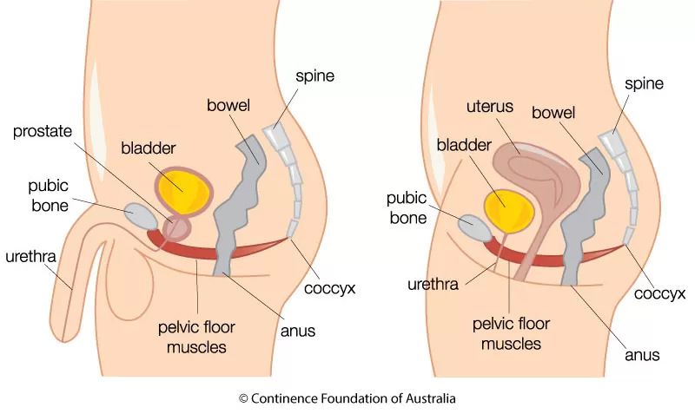
Pelvic Floor
Your pelvic floor is what holds all your lower organs up (bladder, bowels, uterus) and is a very important part of your body. Maintain the strength of your pelvic floor by avoiding heavy strain/constipation and doing pelvic floor exercises.
Pelvic floor problems can be caused by:
Constipation/straining to empty bowels
Frequent heavy lifting or strain (work/gym)
Pregnancy and childbirth
Previous injury to the pelvic region (e.g. a fall, surgery, or pelvic radiotherapy)
Excess weight
Chronic coughing or sneezing
Signs of pelvic floor problems:
Feel­ing of heav­i­ness or pres­sure in pelvic area
Lack of bladder/bowel control
Urinary leakage when coughing/sneezing/exercising
Increased fre­quen­cy and/​or urgency to urinate
Vaginal or anal prolapse
Painful sex or pelvic pain

Slide 39
q+a

Slide 40
trans positive sexual health resources
Bang - masturbation guide
APTN - what they don’t tell you in sex ed!
Trans Bodies, Trans Selves
Personal Lubricants
Brazen: Trans Women’s Safer Sex Guide
PUMP - trans men who have sex with men
Primed: A sex guide for trans men into men
Vogue - Trans People on Sex Ed
Sex Toy for T Growth

